Slide 1
WELCOME TO THE HOSPITAL ANALYSIS PROJECT
by chetan

Slide 2
🏥 Hospital Management Dataset Overview
The dataset consists of 5 key files capturing hospital operations:
Appointments: Tracks patient visits, reasons, assigned doctors, and appointment status
Billing: Records treatment charges, payment methods, and payment status for financial tracking
Doctors: Contains doctor profiles, specialization, contact information, and experience
Patients: Stores patient demographics, contact details, insurance info, and registration data
Treatments: Details the treatments provided, linked with appointments, including type, cost, and description
🔹 Purpose: Enables end-to-end hospital analysis covering patient flow, treatment history, billing, and doctor performance.

Slide 3
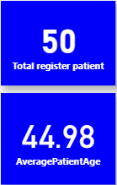
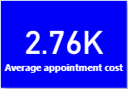
Key insights
Patient & Appointment Overview
📊 Key Performance Indicators (KPIs) Overview
Total Registered Patients (50): Represents the total number of patients who have registered with the hospital. This KPI helps monitor patient reach and overall hospital growth.
Average Patient Age (44.98 Years): Reflects the average age of registered patients. Useful for understanding the hospital’s patient demographics and planning age-specific services.
Average Appointment Cost (₹2.76K): Indicates the average revenue generated per appointment. Essential for financial analysis, cost control, and pricing strategies.

Slide 4
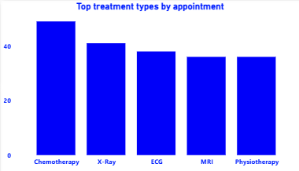
Key insights
🏥 Top Treatment Types by Appointment
This bar chart highlights the most frequently availed treatments by patients, based on appointment records.
Chemotherapy has the highest number of appointments, indicating a strong demand for oncology services.
X-Ray, ECG, MRI, and Physiotherapy follow closely, showing their significance in routine diagnostics and patient care.
🎯 Insights:
Helps the hospital identify high-demand services
Supports resource allocation for treatment departments
Provides a clear view of patient treatment preferences

Slide 5
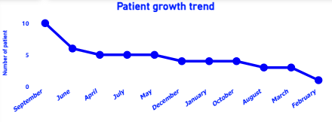
Key insights
📈 Patient Growth Trend
The line chart shows the monthly trend of patient registrations over the analyzed period.
Highest registrations occurred in September, followed by a gradual decline in the following months.
From June onward, patient registrations remained relatively stable with minor fluctuations.
The trend suggests a decrease in new patient intake over time.
🎯 Insights:
Indicates possible seasonal patterns or service demand shifts
Helps in planning for marketing efforts and resource allocation
Useful for forecasting patient inflow in upcoming months

Slide 6
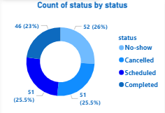
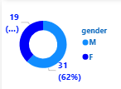
Key insights
📊 Appointment Status & Patient Demographics Overview
Appointment Status Distribution: The donut chart shows a balanced distribution of appointment outcomes:
26% No-show — Patients who missed appointments
25.5% Cancelled — Appointments cancelled by patients or hospital
25.5% Scheduled — Upcoming appointments
23% Completed — Successfully conducted appointments
🎯 Insight: A significant percentage of appointments were either missed or cancelled, highlighting a need for better patient engagement and follow-ups.
Patient Gender Distribution: The gender-wise donut chart indicates:
62% Male Patients (M)
38% Female Patients (F)
🎯 Insight: Male patients form the majority of the hospital’s patient base, which could help tailor communication and services.

Slide 7
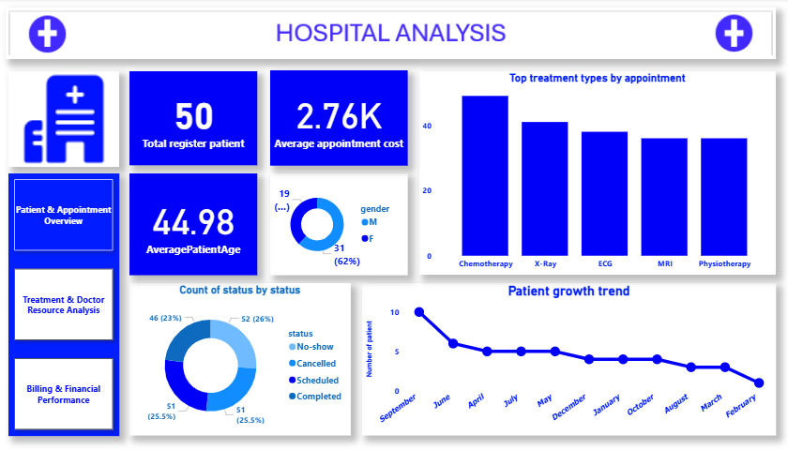
Dashboard

Slide 8
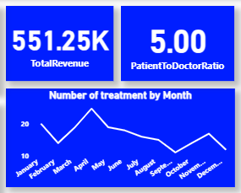
Key insights
Treatment & Doctor Resource Analysis
📊 Hospital Revenue & Treatment Insights
Total Revenue (₹551.25K): Represents the cumulative amount generated from patient treatments and services. This KPI helps assess the financial performance of the hospital over the reporting period.
Patient to Doctor Ratio (5.00): Indicates the average number of patients handled per doctor. A key metric for evaluating staff workload, operational efficiency, and resource management.
Number of Treatments by Month (Line Chart): The line chart displays monthly treatment volumes:
Peak treatment activity observed in April
Noticeable fluctuations throughout the year
Helps identify demand patterns and seasonal trends
🎯 Insights:
Financial health and doctor workload are closely monitored through KPIs
Treatment trend analysis supports planning for staffing, equipment, and patient services

Slide 9
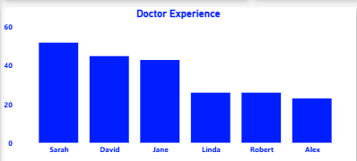
Key insights
👩‍⚕️ Doctor Experience Analysis
This bar chart represents the years of experience of doctors associated with the hospital.
Sarah, David, and Jane are among the most experienced doctors, each with over 40 years of practice.
Linda, Robert, and Alex have comparatively lesser experience, ranging between 20 to 30 years.
🎯 Insights:
The hospital benefits from a mix of highly experienced and mid-level doctors.
Helps management in assigning critical cases or mentoring roles based on experience.
Supports strategic planning for workforce development and succession planning.

Slide 10
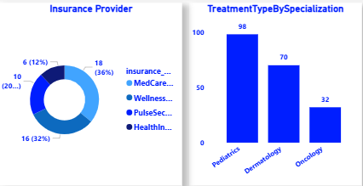
Key insights
📊 Insurance Provider & Treatment Specialization Insights
Insurance Provider Distribution (Donut Chart):
MedCare (36%) is the most common insurance provider among patients.
Followed by Wellness (32%), PulseSecure (20%), and HealthInsure (12%). 🎯 Insight: A few key insurance providers dominate patient coverage — useful for partnerships and billing strategies.
Treatment Type by Specialization (Bar Chart):
Pediatrics (98 cases) leads in the number of treatments performed.
Dermatology (70 cases) and Oncology (32 cases) follow. 🎯 Insight: Pediatrics services are in highest demand, guiding resource planning and specialization focus.

Slide 11
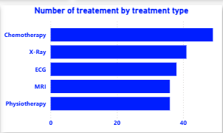
Key insights
🏥 Number of Treatments by Treatment Type
This horizontal bar chart shows the most commonly performed treatment types in the hospital:
Chemotherapy leads with the highest number of treatments, reflecting significant oncology service demand.
Followed by X-Ray and ECG, highlighting the importance of diagnostic procedures.
MRI and Physiotherapy also show consistent treatment volumes.
🎯 Insights:
Helps identify which treatments are most in demand.
Supports decision-making for resource allocation, equipment purchase, and staffing in high-demand areas.
Useful for strategic planning and enhancing patient care services.

Slide 12
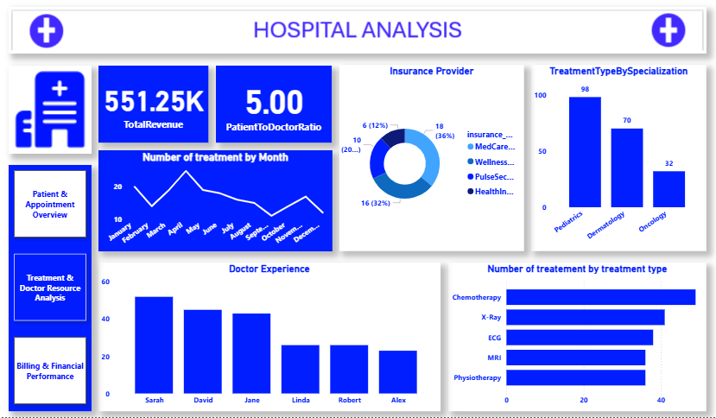
Dashboard

Slide 13
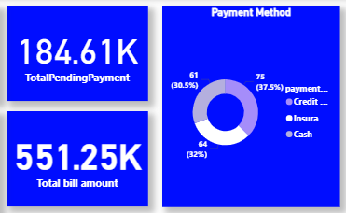
Key insights
Billing & Financial Performan
Total Pending Payment
₹184.61K is the total amount that is yet to be collected.
This figure highlights the pending dues from patients or insurance providers.
Total Bill Amount
₹551.25K is the total billed amount.
This shows the total revenue expected from all bills raised.
Payment Method Breakdown (Donut Chart)
The chart displays the distribution of payments received via different methods:
Credit: 75 payments (37.5%)
Insurance: 64 payments (32%)
Cash: 61 payments (30.5%)
This helps in understanding which payment method is most commonly used, which in this case is Credit.
Insights:
A significant portion of payments is made through Credit, followed by Insurance, and then Cash.
About 33% of the billed amount is still pending, which may require attention for follow-ups or collection efforts.
The dashboard offers a quick glance at both revenue collection and payment method trends, useful for financial monitoring and decision-making.

Slide 14
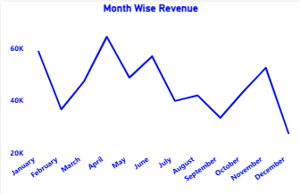
Key insights
Observations:
The revenue shows high fluctuation throughout the months.
January started strong with revenue slightly above 60K, but there is a noticeable drop in February.
A steady increase from March to April, with April reaching the highest peak of the year (above 70K).
After April, the revenue fluctuates:
May and June show a slight dip but remain relatively high.
July sees a decline, followed by a minor increase in August.
September again shows a dip, reaching one of the lower points.
October recovers with a noticeable increase.
November continues upward.
December drops sharply, ending the year on a low note (around 20K).
Insights:
The business seems seasonal, with peaks around April and October-November.
December’s sharp drop may indicate a seasonal slowdown or other external factors affecting revenue.
Monitoring these patterns can help in forecasting and resource planning for high and low revenue months.

Slide 15
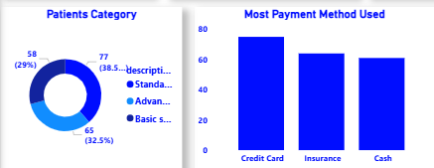
Key insights
1. Patients Category (Donut Chart)
This chart categorizes patients into three segments:
Standard (38.5%) — 77 patients
Advance (32.5%) — 65 patients
Basic Services (29%) — 58 patients
The Standard category has the highest number of patients, followed by Advance and Basic services.
Insight:
Most patients are opting for Standard services, showing it as the most preferred category.
The difference between categories is not huge, indicating a fairly even distribution among service preferences.
2. Most Payment Method Used (Bar Chart)
The bar chart shows the number of times each payment method was used:
Credit Card — highest, around 80 transactions
Insurance — slightly lower, around 70 transactions
Cash — lowest among the three but still significant, around 65 transactions
Insight:
Credit Card is the most commonly used payment method.
Insurance and Cash also have strong usage, indicating a diverse preference in payment options.
This suggests the importance of offering multiple payment methods to accommodate patient needs.

Slide 16
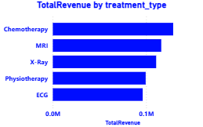
Key insights
Observations:
Chemotherapy generated the highest revenue, crossing 0.1M (100K), making it the top contributor.
MRI follows closely behind with slightly less than chemotherapy.
X-Ray comes next, showing strong revenue generation.
Physiotherapy ranks fourth, with a slightly lower contribution.
ECG has the lowest total revenue among the listed treatments.
Insights:
High-value treatments like Chemotherapy and MRI are key revenue drivers for the healthcare facility.
X-Ray and Physiotherapy also contribute significantly.
ECG, though essential, generates comparatively lower revenue.

Slide 17
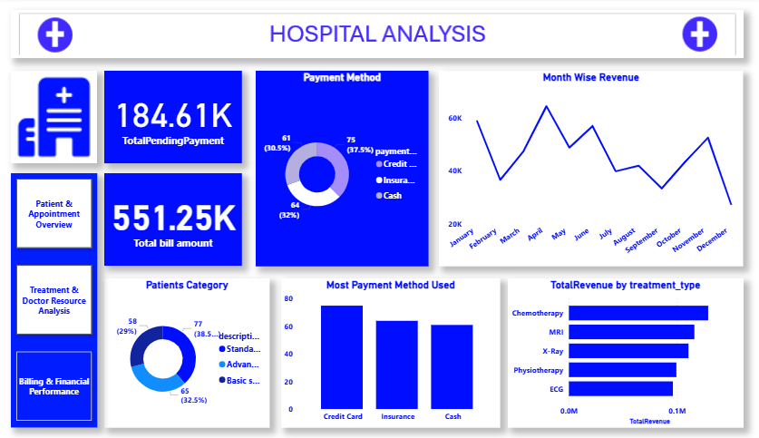
Dashboard

Slide 18
Thank you

